Slide 1
Named Entity Recognition and Information Extraction

Slide 2
Regular Expressions
Regular expressions are sequences of characters that define a search pattern.
They are used for string matching and manipulation.
In Python, the re module provides support for working with regular expressions

Slide 3
Basic Components of Regular Expressions
Literals
Metacharacters
Character Classes
Quantifiers
Anchors
Group and Alternation

Slide 4
Literals
Characters that match exactly themselves.
Example: a matches the character 'a' in the text.

Slide 5
Metacharacters
Characters with special meanings in regex.
Common metacharacters include . ^ $ * + ? { } [ ] \ | ( )
Used with escape sequence \

Slide 6
Character Classes
Define a set of characters that you want to match.
[abc] matches any one of the characters 'a', 'b', or 'c’.
[a-z] matches any lowercase letter.
\d matches any digit (equivalent to [0-9]).
\D matches ^\d
\w matches any word character (alphanumeric + underscore, equivalent to [A-Za-z0-9_]).
\W matches ^\w
\s matches any whitespace character (spaces, tabs, newlines).
\S matches ^\s

Slide 7
Quantifiers
Define how many times an element should be matched.
* matches 0 or more times.
+ matches 1 or more times.
? matches 0 or 1 time.
{n} matches exactly n times.
{n,} matches n or more times.
{n,m} matches between n and m times.

Slide 8
Anchors
Specify positions in the text where matches must occur.
^ matches the start of a string.
$ matches the end of a string.
Examples:
^Hello
"Hello, world!“ - match
"Well, Hello there!“ – no match
world!$
"Hello, world!“ - match
"Hello, world.“ – no match

Slide 9
Group and Alternation
() creates a group.
| is used for alternation (logical OR).
( tells where string extraction is to start
) tells where string extraction is to end

Slide 10
Some Examples
Regular expression for an Indian mobile number:
^(\+91[\-\s]?)?[6-9]{1}[0-9]{9}$
Validate an Email Address:
^[a-zA-Z0-9._%+-]+@[a-zA-Z0-9.-]+\.[a-zA-Z]{2,}$
Validate a URL:
^(https?:\/\/)?([\da-z\.-]+)\.([a-z\.]{2,6})([\/\w \.-]*)*\/?$
Match a Date in YYYY-MM-DD Format:
^\d{4}-(0[1-9]|1[0-2])-(0[1-9]|[12][0-9]|3[01])$
Validate a Password:
^(?=.*[a-z])(?=.*[A-Z])(?=.*\d)(?=.*[@$!%*?&])[A-Za-z\d@$!%*?&]{8,}$
Match a U.S. ZIP Code(5-digit and 5+4 format):
^\d{5}(?:[-\s]\d{4})?$

Slide 11
Mobile Number and Email Address
Regular expression for an Indian mobile number:
^(\+91[\-\s]?)?[6-9]{1}[0-9]{9}$
Validate an Email Address:
^[a-zA-Z0-9._%+-]+@[a-zA-Z0-9.-]+\.[a-zA-Z]{2,}$

Slide 12
URL and MMMM-DD-YY format Date
Validate a URL:
^(https?:\/\/)?([\da-z\.-]+)\.([a-z\.]{2,6})([\/\w \.-]*)*\/?$
Match a Date in YYYY-MM-DD Format:
^\d{4}-(0[1-9]|1[0-2])-(0[1-9]|[12][0-9]|3[01])$

Slide 13
Password and US Zip Code
Validate a Password:
^(?=.*[a-z])(?=.*[A-Z])(?=.*\d)(?=.*[@$!%*?&])[A-Za-z\d@$!%*?&]{8,}$
Match a U.S. ZIP Code(5-digit and 5+4 format):
^\d{5}(?:[-\s]\d{4})?$

Slide 14
Regular Expression Methods
Performs queries on an input string
re.match()
re.search()
re.findall()
re.sub()
re.compile()

Slide 15

re.match()
Syntax: re.match(pattern, sequence, flags = 0)
Pattern - This is the regular expression to be matched
Sequence - The string that would be searched to match the pattern at the beginning of string.
Flags - Different flags are specified using bitwise OR (|).
import re
pattern = r"Cookie"
sequence = "Cookie"
if re.match(pattern, sequence):
print("Match!")
else: print("Not a match!")
import re
str= "my college is marian college I love my college"
print("match")
str1=re.match(r'college',str)
print(str1)
Examples

Slide 16

re.search()
Syntax: search(pattern, sequence, flags=0)
The match method checks for a match only at the beginning of the string while search checks for a match anywhere in the string.
Examples
import re
str= "my college is marian college i love my college"
print("search")
str2=re.search(r'college',str)
print(str2)
import re
pattern = "cookie"
sequence = "Cake and cookie"
print(re.search(pattern, sequence).group())

Slide 17


re.findall()
Syntax: findall(pattern, string, flags=0)
Finds all the possible matches in the entire sequence and returns them as a list of strings.
Examples
import re
email_address = "Please contact us at: support@mariancollege.com, xyz@mariancollege.com"
#'addresses' is a list that stores all the possible match
addresses = re.findall(r'[\w\.-]+@[\w\.-]+', email_address)
for address in addresses:
print(address)
import re
str= "my college is marian college i love my college"
print("find all....")
str3=re.findall(r'college',str)
print(str3)

Slide 18

re.sub()
Syntax: re.sub(the regular expression, the replacement string, the source string)
Performs string replacement, returning a new string based on the groups in the original one
Examples
import re
str= "my college is marian college i love my college"
str3=re.sub(r'college','ddd',str)
print(str3)
import re
phone = "2004-959-559 # This is Phone Number"
# Delete Python-style comments
num = re.sub(r'#.*$', "", phone)
print ("Phone Num : ", num)

Slide 19

Example of re.sub()
import re
# Sample string with dates
text = "Today's date is 19-07-2024"
# Pattern to match dates in the format dd-mm-yyyy
pattern = r'(\d{2})-(\d{2})-(\d{4})'
# Replacement pattern
replacement = r'\1/\2/\3'
# Using re.sub() to replace hyphens with slashes
result = re.sub(pattern, replacement, text)
print("Original text:", text)
print("Modified text:", result)

Slide 20
re.compile()
Syntax: re.compile(pattern, flags=0)
pattern: regex pattern in string format
flags: an optional parameter
re.compile() method returns a pattern object ( i.e., re.Pattern).
Used to compile a regular expression pattern provided as a string into a regex pattern object
This pattern object can be used to search for a match inside different target strings using regex methods such as a re.match() or re.search()

Slide 21
re.compile()
Examples
import re
# Sample text
text = "This is a simple text with words of various lengths. Let's find a five-letter word like 'apple'."
# Compile a regular expression to match a 5-letter word
pattern = re.compile(r'\b\w{5}\b')
# Search for the pattern in the text
matches = pattern.findall(text)
# Print the matches
print("5-letter words found:", matches)
import re
# Sample text
text = "In 2024, there were 123 students enrolled in the course. The room numbers were 101, 204, and 303."
# Compile a regular expression to match a 3-digit number
rn = re.compile(r'\b\d{3}\b')
# Search for the pattern in the text
matches = pattern.findall(text)
# Print the matches
print("3-digit numbers found:", matches)

Slide 22
Difference between [abc] and (abc)
Character Class [abc]:
[abc] matches any single character that is either a, b, or c.
Used to define a set of characters, any one of which can occur at a specific position in the string.
For example, the pattern [abc] will match a, b, or c in the string.
Group (abc):
(abc) matches the exact sequence of characters abc in that order.
Used to create a capturing group, which can be useful for extracting parts of a match or applying quantifiers to the entire group.
For example, the pattern (abc) will match the substring abc exactly in the string.

Slide 23
Python Programs for [abc] and (abc)
import re
pattern = r’[abc]'
text = 'apple, banana, cat, dog'
matches = re.findall(pattern, text)
print(matches)
import re
pattern = r'(abc)’
text = 'apple banana abc def abc’
matches = re.findall(pattern, text)
print(matches)

Slide 24

Example of Grouping
#Examples of Grouping-1
#capturing groups
import re
pattern = r"(\w+)@(\w+)\.(\w+)"
text = "user@example.com"
match = re.match(pattern, text)
if match:
print("Full match:", match.group(0)) # Full match
print("Group 1:", match.group(1)) # 'user'
print("Group 2:", match.group(2)) # 'example'
print("Group 3:", match.group(3)) # 'com'

Slide 25
The Regular Expression \b
A word boundary anchor
Asserts a position where a word character (usually [A-Za-z0-9_]) is next to a non-word character
Word Boundary:
\b matches the position between a word character and a non-word character or between a word character and the start/end of a string.
Non-Word Boundary:
\B is the opposite of \b. It matches the position between two word characters or two non-word characters

Slide 26
Examples of \b
Example 1: Matching Whole Words
Pattern: r'\bword\b’
Matches: word, word., word!
Does not match: sword, words
Example 2: Word Boundaries in a Sentence
Pattern: r'\bcat\b’
Text: "The cat is on the mat. Concatenate these words.“
Matches: cat
Does not match: Concatenate

Slide 27
Python Program for \b
import re
# Sample text
text = "The cat is on the mat. Concatenate these words."
# Pattern to match the word 'cat' as a whole word
pattern = r'\bcat\b'
# Finding all matches
matches = re.findall(pattern, text)
print("Matches:", matches)

Slide 28
Significance of . in Regex
A special metacharacter that matches any single character except a newline
The dot matches exactly one character of any kind (letters, digits, punctuation, etc.)
Example 1: Basic Single Character Match
Pattern: a.b
Matches: acb, a1b, a-b
Example 2: Using Dot in a More Complex Pattern
Pattern: a..b
Matches: axxb, a12b, a—b
Example 3: Combining with Other Metacharacters
Pattern: a.*b
Matches: ab, axb, a123b, a...b
Example 4: Dot with ? (Zero or One)
Pattern: a.?b
Matches:ab, axb

Slide 29
Information Extraction
Process of automatically extracting structured information from unstructured text.
Includes tasks like identifying relationships between entities and converting text into a structured format.
Key Tasks in IE:
Named Entity Recognition (NER): Identifying and classifying entities in text.
Relation Extraction: Identifying relationships between entities (e.g., "John works at Google").
Event Extraction: Identifying events and their participants (e.g., "The conference was held in Paris").

Slide 30
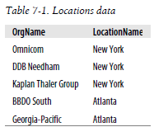
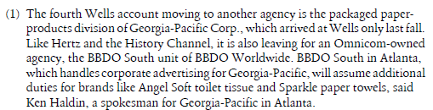
Information Extraction
Given a particular company, we would like to be able to identify the locations where it does business; conversely, given a location, we would like to discover which companies do business in that location.
Structured Text: Unstructured Text:
We first convert the unstructured data of natural language sentences into the structured data of Table 7-1. Then we reap the benefits of powerful query tools such as SQL. This method of getting meaning from text is called Information Extraction.

Slide 31
Information Extraction Architecture
This begins by processing a document using several procedures
First, the raw text of the document is split into sentences using a sentence segmenter
Then each sentence is further subdivided into words using a tokenizer.
Next, each sentence is tagged with part-of-speech tags
Next step is named entity recognition, where we search for mentions of potentially interesting entities in each sentence.
Finally, we use relation recognition to search for likely relations between different entities in the text.

Slide 32
How NER works?
Sentence Segmentation
Raw text is divided into its component sentences.
Assigns sentence boundaries and splits the text whenever punctuation marks or periods are detected.
Word Tokenization
Identifying the words that constitute a string of characters before processing a natural language.
Part of Speech Tagging (POS)
Describes the characteristic structure of lexical terms within a text or sentence.
It assigns up a word in a text to a corresponding Part of Speech tag according to its context.
With the help of POS tags, we can make assumptions about the text semantics.

Slide 33
How NER works? Contd…
Entity Recognition
Identification of Named Entities:
Purpose: Entity Recognition focuses on identifying and classifying named entities in text, such as people, organizations, locations, dates, and other specific items.
Example: In the sentence "Barack Obama was born in Hawaii," entity recognition would identify "Barack Obama" as a PERSON and "Hawaii" as a LOCATION.
Classification into Categories:
Purpose: Once entities are recognized, they are classified into predefined categories such as PERSON, ORGANIZATION, LOCATION, etc., based on their context and usage in the text.
Example: In the sentence "Microsoft announced a new product in Seattle," "Microsoft" would be classified as an ORGANIZATION, and "Seattle" would be classified as a LOCATION.

Slide 34
How NER works? Contd…
Relation Recognition
Detection of Relationships Between Entities:
Purpose: Relation Recognition aims to identify and categorize the relationships between recognized entities in the text, such as "works for," "located in," or "founded by."
Example: In the sentence "Bill Gates founded Microsoft," the relation recognition process would identify "founded by" as the relationship between "Bill Gates" (PERSON) and "Microsoft" (ORGANIZATION).
Contextual Understanding of Relationships:
Purpose: Understanding the context in which entities appear helps in accurately defining their relationships. This involves analyzing the sentence structure and the semantic meaning of the text.
Example: In the sentence "Amazon acquired Whole Foods," relation recognition would identify the relationship "acquired by" between "Amazon" (ORGANIZATION) and "Whole Foods" (ORGANIZATION).

Slide 35
PoS Tagging
Involves labeling each word in a sentence with its corresponding part of speech, such as noun, verb, adjective, etc.
This tagging helps in understanding the grammatical structure and semantics of the sentence.
Example Sentence: “The quick brown fox jumps over the lazy dog.”
Tagged Sentence:
The/DT (Determiner)
quick/JJ (Adjective)
brown/JJ (Adjective)
fox/NN (Noun, Singular)
jumps/VBZ (Verb, 3rd Person Singular Present)
over/IN (Preposition)
the/DT (Determiner)
lazy/JJ (Adjective)
dog/NN (Noun, Singular)

Slide 36
Another Example of PoS
Example Sentence: “Alice visited New York last summer.”
Tagged Sentence:
Alice/NNP (Proper Noun, Singular)
visited/VBD (Verb, Past Tense)
New/NNP (Proper Noun, Singular)
York/NNP (Proper Noun, Singular)
last/JJ (Adjective)
summer/NN (Noun, Singular)

Slide 37
How PoS Tagging Helps with NER
Identifying Names and Titles
By knowing whether a word is a proper noun, it becomes easier to recognize names of people and places.
Understanding Context
Adjectives and verbs can provide additional context to help in distinguishing between different types of entities.
For instance, in the sentence “Apple is looking at buying U.K. startup for $1 billion,” PoS tagging can help distinguish that “Apple” is a proper noun (likely an organization), “U.K.” is a proper noun (a location), and “$1 billion” is a monetary value.

Slide 38
Abbreviations NN, NNP, VB, VBD, VBG, JJ and RB
Nouns
NN: Noun, Singular or Mass (e.g., dog, city)
NNP: Proper Noun, Singular (e.g., Alice, Paris)
Verbs
VB: Verb, Base Form (e.g., run, eat)
VBD: Verb, Past Tense (e.g., ran, ate)
VBG: Verb, Gerund or Present Participle (e.g., running, eating)
Adjectives
JJ: Adjective (e.g., happy, blue)
Adverbs
RB: Adverb (e.g., quickly, never)

Slide 39
Basic PoS Categories
Nouns (NN, NNP)
Definition: Words that represent people, places, things, or ideas.
Examples:
Common Nouns: cat, city, car
Proper Nouns: Alice, Paris, Toyota
Function: Serve as subjects or objects in a sentence.
Usage: "The dog chased the ball."
Verbs (VB, VBD, VBG)
Definition: Words that describe actions, states, or occurrences.
Examples:
Action Verbs: run, eat, write
State Verbs: be, seem, know
Function: Indicate what the subject is doing or experiencing.
Usage: "She runs every morning."

Slide 40
Basic PoS Categories contd…
Adjectives (JJ)
Definition: Words that describe or modify nouns.
Examples:
Descriptive Adjectives: tall, happy, blue
Quantitative Adjectives: few, many, several
Function: Provide more information about a noun.
Usage: "The red apple is on the table."
Adverbs (RB)
Definition: Words that modify verbs, adjectives, or other adverbs, often indicating how, when, where, or to what extent.
Examples:
Manner Adverbs: quickly, carefully, well
Frequency Adverbs: always, never, often
Function: Give details about the action or quality.
Usage: "He runs quickly."

Slide 41
Other Common PoS Tags
Determiners (DET)
DET: Determiner
Definition: Words that introduce nouns and specify them in terms of definiteness, quantity, etc.
Examples:
Articles: the, a
Demonstratives: this, those
Quantifiers: some, many
Prepositions (IN)
IN: Preposition
Definition: Words that link nouns, pronouns, or phrases to other words in a sentence.
Examples:
in, on, at
by, with, about

Slide 42
Additional Common POS Tags
PRP: Personal Pronoun (e.g., he, they)
PRP$: Possessive Pronoun (e.g., his, their)
CC: Coordinating Conjunction (e.g., and, but)
RB: Adverb (e.g., quickly, very)
RBR: Adverb, Comparative (e.g., faster)
RBS: Adverb, Superlative (e.g., fastest)
JJ: Adjective (e.g., big, blue)
JJR: Adjective, Comparative (e.g., bigger)
JJS: Adjective, Superlative (e.g., biggest)
VBZ: Verb, 3rd Person Singular Present (e.g., runs, eats)

Slide 43
Chunked Sentences
Chunking is a process in NLP where a sentence is divided into chunks or phrases, typically based on their grammatical functions
Chunking builds on PoS tags to group related words into phrases (e.g., noun phrases, verb phrases).
PoS Tagging provides the basic grammatical information needed to identify chunks. For example, identifying a sequence of words with tags like DT (determiner) and NN (noun) as a noun phrase.
Chunking uses these PoS tags to assemble these words into larger units, such as noun phrases or verb phrases, based on predefined rules or patterns.

Slide 44
Types of Chunks
Noun Phrases (NP): Groups of words that function as a noun.
Example: The quick brown fox
Verb Phrases (VP): Groups of words that function as a verb.
Example: jumps over the lazy dog
Prepositional Phrases (PP): Groups of words that start with a preposition.
Example: over the lazy dog

Slide 45
NLTK Program for PoS tagging:
import nltk
nltk.download('punkt')
nltk.download('averaged_perceptron_tagger')
from nltk.tokenize import word_tokenize
from nltk.tag import pos_tag
sentence = "The quick brown fox jumps over the lazy dog"
words = word_tokenize(sentence)
print("Words:")
print(words)
pos_tags = pos_tag(words)
print("PoS Tags:")
print(pos_tags)

Slide 46
Punkt is a sentence tokenizer that uses an unsupervised algorithm to build a model for abbreviation words and collocations. It's part of the nltk.tokenize.punkt module, which divides text into a list of sentences.
The averaged perceptron tagger in NLTK is a part-of-speech (POS) tagger that uses the averaged perceptron algorithm to classify words in a text according to their grammatical categories. The averaged perceptron tagger has been the default POS tagger in NLTK.

Slide 47
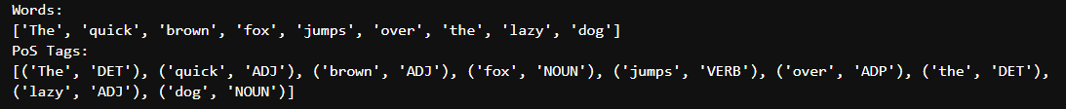
spaCy Program for PoS tagging:
import spacy
# Load the spaCy model
nlp = spacy.load("en_core_web_sm")
# Define the sentence
sentence = "The quick brown fox jumps over the lazy dog"
# Process the sentence using the spaCy model
doc = nlp(sentence)
# Extract words and their PoS tags
words = [token.text for token in doc]
pos_tags = [(token.text, token.pos_) for token in doc]
print("Words:")
print(words)
print("PoS Tags:")
print(pos_tags)

Slide 48
Program Explanation
nlp=spacy.load("en_core_web_sm")
loads an NLP model object, called en_core_web_sm that's trained on written web text.
The pipeline includes vocabulary, syntax, and entities
doc = nlp(text)
With the nlp object created, we can use it to parse a text. To do this, we create a doc object. This object will contain a lot of data on the text
print(doc) vs. for ent in doc.ents: (ent)
spaCy sentence tokenizer produces a text correctly broken into sentences
for ent in doc.ents: print(ent.text, ent.label_)
Prints each entity’s text (the string itself) and its corresponding label
for token in doc: (token.text, token.pos_)
Prints each entity’s text and its corresponding PoS tags

Slide 49
Chunking using spaCy
import spacy
from spacy import displacy
# Load the spaCy model
nlp = spacy.load("en_core_web_sm")
# Define the sentence
sentence = "The quick brown fox jumps over the lazy dog"
# Process the sentence using the spaCy model
doc = nlp(sentence)
# Extract words and their PoS tags
words = [token.text for token in doc]
pos_tags = [(token.text, token.pos_) for token in doc]
print("Words:")
print(words)
print("PoS Tags:")
print(pos_tags)

Slide 50
Chunking using spaCy contd…
# Print the chunks (noun phrases in this case)
print("Chunks:")
for chunk in doc.noun_chunks:
print("Chunk:", chunk.text, "Root Text:", chunk.root.text, "Root Dep:", chunk.root.dep_, "Root Head Text:", chunk.root.head.text)
# Visualize the PoS tree
options = {
"compact": True,
"color": "blue",
"bg": "#f0f0f0",
"font": "Arial"
}
displacy.render(doc, style="dep", options=options)

Slide 51
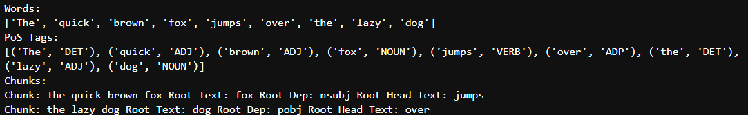
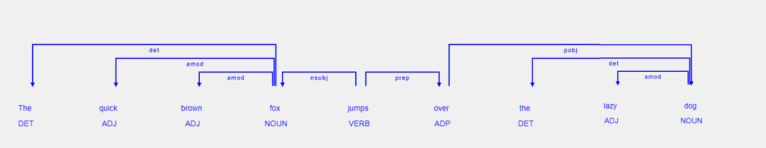
Chunking using spaCy Output…

Slide 52
Interpretation of Output
for chunk in doc.noun_chunks:
Iterate over the noun chunks in the document.
Print each chunk's text, the root text of the chunk, the dependency label of the root, and the head text of the root.
Chunk: This is a contiguous span of tokens that form a meaningful unit, usually a noun phrase.
Root Text: This is the central word of the chunk, which usually carries the main semantic weight of the phrase. For noun chunks, this is typically the noun itself.
Root Dep: This is the dependency label of the root word. It describes the syntactic relationship between the root word of the chunk and the rest of the sentence.
Root Head Text: This is the word to which the root word is syntactically linked in the dependency parse of the sentence.

Slide 53
Interpretation of Output
First chunk:
Chunk: The quick brown fox Root Text: fox Root Dep: nsubj Root Head Text: jumps
Root Dep: nsubj (nominal subject)
The noun "fox" is the subject of the verb "jumps".
Root Head Text: "jumps"
The root word "fox" is syntactically linked to the verb "jumps". In other words, "fox" is performing the action described by "jumps".
The parsed chunks and their attributes help us understand the grammatical structure of the sentence. Specifically:
"The quick brown fox" is the subject of the sentence.
"fox" is the main noun, and it is performing the action "jumps".
"the lazy dog" is the object of the preposition "over".
"dog" is the main noun in the prepositional phrase "over the lazy dog".

Slide 54
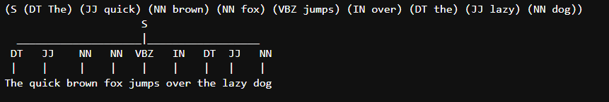
NLTK Program for PoS in Tree Structure:
import nltk
nltk.download('punkt')
nltk.download('averaged_perceptron_tagger')
from nltk.tokenize import word_tokenize
from nltk.tag import pos_tag
from nltk import Tree
sentence = "The quick brown fox jumps over the lazy dog"
words = word_tokenize(sentence)
pos_tags = pos_tag(words)
# Create a tree structure
tree_structure = "(S " + " ".join(f"({tag} {word})" for word, tag in pos_tags) + ")“
print(tree_structure)
# Create a tree from the structure
tree = Tree.fromstring(tree_structure)
# Visualize the tree
tree.pretty_print()

Slide 55

Python Program for Chunked Sentences:
import nltk
nltk.download('punkt')
nltk.download('averaged_perceptron_tagger')
from nltk.tokenize import word_tokenize
from nltk.tag import pos_tag
from nltk import RegexpParser
sentence = "The quick brown fox jumps over the lazy dog"
words = word_tokenize(sentence)
pos_tags = pos_tag(words)
# Define a simple grammar for chunking
grammar = r"""
NP: {<DT|JJ|NN.*>+} # Noun phrases
VP: {<VB.*><NP|PP|CLAUSE>+} # Verb phrases
CLAUSE: {<NP><VP>} # Clauses
"""
chunk_parser = RegexpParser(grammar)
chunks = chunk_parser.parse(pos_tags)
# Print the chunks
for chunk in chunks:
if isinstance(chunk, nltk.Tree):
print(chunk.label(), " ".join(word for word, _ in chunk.leaves()))

Slide 56

NER Python Program
import nltk
nltk.download('punkt')
nltk.download('averaged_perceptron_tagger')
nltk.download('maxent_ne_chunker')
nltk.download('words')
from nltk import ne_chunk
from nltk.tokenize import word_tokenize
# Example sentence
sentence = "Microsoft Corporation is headquartered in Redmond, Washington."
# Tokenize the sentence
words = word_tokenize(sentence)
# Perform NER
ner_tags = ne_chunk(nltk.pos_tag(words))
# Print named entities
for subtree in ner_tags:
if isinstance(subtree, nltk.Tree):
entity = " ".join(word for word, tag in subtree.leaves())
print(f"{entity}: {subtree.label()}")

Slide 57
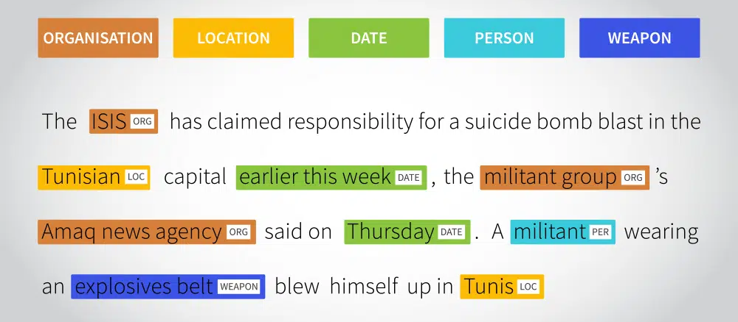
Named Entity Recognition
Process of identifying and classifying named entities in text into predefined categories such as names of people, organizations, locations, dates, and quantities.

Slide 58
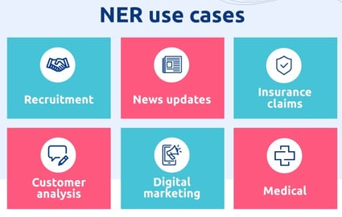
NER Applications
Content Recommendation
Suggests relevant content based on identified entities.
Information Retrieval
Enhances search results by identifying relevant entities.
Question Answering
Improves accuracy by focusing on specific entities.
Text Summarization
Identifies key entities for summary creation.

Slide 59
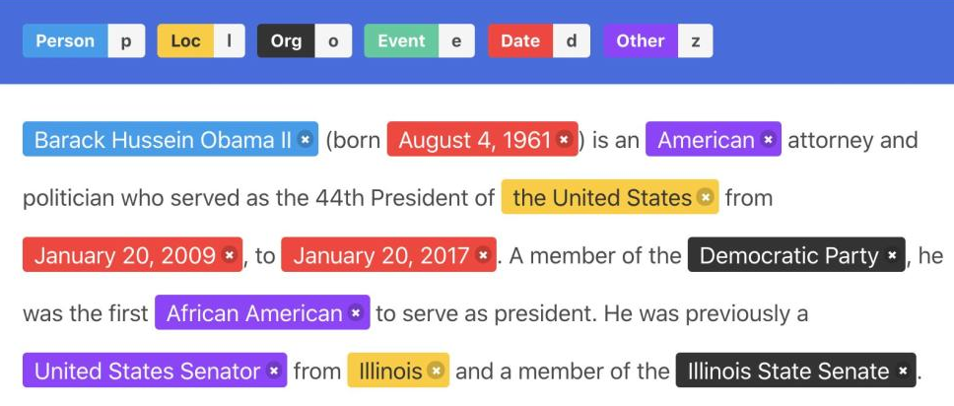
Categories of Named Entities:
Person: Names of individuals (e.g., "Albert Einstein").
Organization: Names of companies, institutions (e.g., "Google").
Location: Geographic entities (e.g., "New York").
Date/Time: Specific dates and times (e.g., "2024-07-09").
Monetary Values: Financial amounts (e.g., "$100").

Slide 60
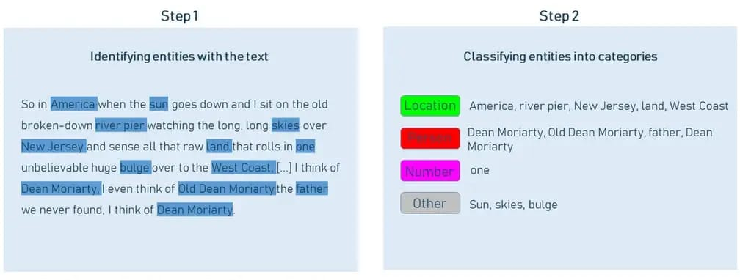
2 Steps in NER
Entity Detection
Entity Classification

Slide 61
Entity Detection
Initial and fundamental phase in the NER process.
Involves systematically scanning and identifying chunks of text that potentially represent meaningful entities.
Tokenization
Process of breaking this string into meaningful pieces called tokens
Simplifies the subsequent analytical steps by converting the text into manageable units
Feature Extraction
Understanding the significance of these tokens
Involves analyzing the properties of tokens, such as:
morphological features that deal with the form of words, like their root forms or prefixes
syntactic features that focus on the arrangement and relationships of words in sentences
semantic features that capture the inherent meaning of words and can sometimes tap into broader world knowledge or context to better understand a token's role.

Slide 62
Entity Classification
Involves assigning the identified entities to specific categories or classes based on their semantic significance and context
https://www.altexsoft.com/blog/named-entity-recognition/

Slide 63

Identifying Named Entities
import spacy
# Load pre-trained NER model
nlp = spacy.load("en_core_web_sm")
text = "Apple Inc. was founded by Steve Jobs and Steve Wozniak in Cupertino."
doc = nlp(text)
# Extract named entities
for ent in doc.ents:
print(ent.text, ent.label_)

Slide 64

Identifying Named Entities
import spacy
# Load pre-trained NER model
nlp = spacy.load("en_core_web_sm")
doc = nlp("Apple is looking at buying UK startup for $1 billion")
# Extract named entities
for ent in doc.ents:
print(ent.text, ent.start_char, ent.end_char, ent.label_)

Slide 65
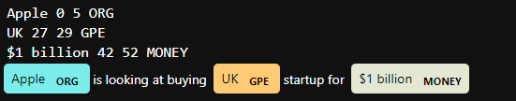
Identifying Named Entities with Visualization
import spacy
from spacy import displacy
# Load pre-trained NER model
nlp = spacy.load("en_core_web_sm")
doc = nlp("Apple is looking at buying UK startup for $1 billion")
# Extract named entities
for ent in doc.ents:
print(ent.text, ent.start_char, ent.end_char, ent.label_)
# Use displacy to visualize named entities
displacy.render(doc, style="ent", jupyter=True)

Slide 66
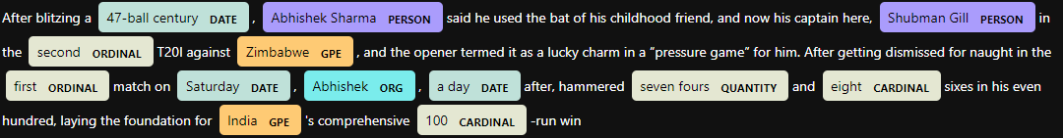
Identifying Named Entities with Visualization
import spacy
from spacy import displacy
# Load pre-trained NER model
nlp = spacy.load("en_core_web_sm")
doc = nlp("After blitzing a 47-ball century, Abhishek Sharma said he used the bat of his childhood friend, and now his captain here, Shubman Gill in the second T20I against Zimbabwe, and the opener termed it as a lucky charm in a “pressure game” for him. After getting dismissed for naught in the first match on Saturday, Abhishek, a day after, hammered seven fours and eight sixes in his even hundred, laying the foundation for India's comprehensive 100-run win")
# Extract named entities
for ent in doc.ents:
print(ent.text, ent.start_char, ent.end_char, ent.label_)
# Use displacy to visualize named entities
displacy.serve(doc, style="ent")

Slide 67
NER Approaches
Rule-Based NER
Simple to implement for well-defined problems.
Effective in domains where patterns are known and stable.
Can be manually fine-tuned to improve accuracy.
Example: Using regex to identify dates in text.
ML-Based NER
Capable of handling more complex and varied data.
Requires training data and computational resources.
Continuously improves with more data and retraining.
Example: Using a pre-trained model like SpaCy or fine-tuning a BERT model for NER.

Slide 68
Rule-Based NER
Rule-based NER uses handcrafted rules and patterns to identify named entities in text
Based on regular expressions, dictionaries, and linguistic patterns.
Components:
Regular Expressions: Patterns used to match sequences of characters in text. For example, regex can be used to identify phone numbers or email addresses.
Lexicons/Dictionaries: Predefined lists of entities (e.g., lists of country names or company names) used to recognize entities in the text.
Pattern Matching: Rules based on the structure of entities, such as capitalization patterns or specific sequences of words.

Slide 69
Rule-Based NER
Advantages:
Simplicity: Easy to implement for well-defined patterns.
Transparency: Rules and patterns are explicit and can be easily understood.
Disadvantages:
Scalability: Difficult to scale to large and diverse datasets.
Flexibility: Struggles with variations in text and context. Hard to adapt to new types of entities or domains without manual updates.
Maintenance: Requires continuous updates to handle new patterns or domain-specific terms.

Slide 70

Rule-Based Email Extraction
import re
# Sample text containing email addresses
text = " Please contact us at support@example.com for further information. You can also reach out to john.doe123@company.net for any queries. Our sales team is available at sales@marketplace.org. "
# Define the regular expression pattern for email addresses
email_pattern = r'\b[A-Za-z0-9._%+-]+@[A-Za-z0-9.-]+\.[A-Z|a-z]{2,}\b’
# Find all email addresses in the text
email_addresses = re.findall(email_pattern, text)
# Print the extracted email addresses
print("Extracted Email Addresses:")
for email in email_addresses:
print(email)

Slide 71
Explanation
1. Import the re Module: The re module provides support for working with regular expressions.
2. Sample Text: Define a string containing some email addresses to be extracted.
3. Define the Regular Expression Pattern:
\b: Word boundary to ensure the pattern matches whole words.
[A-Za-z0-9._%+-]+: One or more characters that are alphanumeric or any of ._%+-.
@: The @ symbol separating the local part and the domain part of the email.
[A-Za-z0-9.-]+: One or more characters that are alphanumeric or any of .- in the domain.\.
[A-Z|a-z]{2,}: A dot followed by 2 or more alphabetic characters (the TLD).
4. Extract Email Addresses: Use re.findall() to find all occurrences of the pattern in the text.
5. Print the Extracted Email Addresses: Iterate through the list of found email addresses and print each one.

Slide 72

Rule-Based NER Using Regex
import re
# Sample text
text = "John Doe went to New York on January 10, 2020 to meet with Jane Smith."
# Regular expressions for detecting names, dates, and locations
name_pattern = re.compile(r'\b[A-Z][a-z]+\s[A-Z][a-z]+\b')
date_pattern = re.compile(r'\b\w+\s\d{1,2},\s\d{4}\b')
location_pattern = re.compile(r'\b[A-Z][a-z]+\s[A-Z][a-z]+\b')
# Find all matches
names = name_pattern.findall(text)
dates = date_pattern.findall(text)
locations = location_pattern.findall(text)
# Print results
print("Names:", names)
print("Dates:", dates)
print("Locations:", locations)

Slide 73
Rule-based NER using SpaCy's Matcher
import spacy
from spacy.matcher import Matcher
# Load pre-trained SpaCy model
nlp = spacy.load("en_core_web_sm")
# Sample text
text = "John Doe went to New York on January 10, 2020 to meet with Jane Smith."
# Create a SpaCy document
doc = nlp(text)
# Initialize the matcher with the SpaCy vocabulary
matcher = Matcher(nlp.vocab)
# Define patterns for matching
name_pattern = [{"POS": "PROPN"}, {"POS": "PROPN"}]
date_pattern = [{"ENT_TYPE": "DATE"}]
location_pattern = [{"ENT_TYPE": "GPE"}]

Slide 74
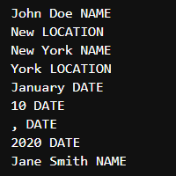
Rule-based NER using SpaCy's Matcher - Output
# Add patterns to the matcher
matcher.add("NAME", [name_pattern])
matcher.add("DATE", [date_pattern])
matcher.add("LOCATION", [location_pattern])
# Apply the matcher to the doc
matches = matcher(doc)
# Extract matched spans
for match_id, start, end in matches:
span = doc[start:end]
label = nlp.vocab.strings[match_id]
# Get the string label for the match ID
print(span.text, label)

Slide 75
Explanation of the Program
Import Necessary Libraries
spacy: This is the main library for NLP tasks.
Matcher: A spaCy component for rule-based matching of tokens, based on token attributes.
Load Pre-trained SpaCy Model
Define Sample Text
Create a SpaCy Document
doc: A spaCy Doc object containing the processed text, including tokenization, PoS tagging, and NER.
Initialize the Matcher
matcher: An instance of the Matcher class, initialized with the spaCy vocabulary.
Define Patterns for Matching
name_pattern: A pattern to match proper nouns (e.g., "John Doe", "Jane Smith"). It looks for two consecutive tokens with the PoS tag PROPN.
date_pattern: A pattern to match dates. It looks for tokens with the entity type DATE.
location_pattern: A pattern to match geopolitical entities (e.g., "New York"). It looks for tokens with the entity type GPE.

Slide 76
Explanation of the Program
Add Patterns to the Matcher
matcher.add: Adds the patterns to the matcher with labels "NAME", "DATE", and "LOCATION".
Apply the Matcher to the Document
matches: A list of match results. Each match is a tuple containing the match ID, start index, and end index of the matched span.
Extract Matched Spans
Iterate through each match and extract the corresponding span from the document.
span.text: The text of the matched span.
span.label_: The label assigned to the matched pattern. However, this will raise an error since span.label does not exist for the matched span. Instead, it should use the match ID.

Slide 77
Span in NLP
Refers to a contiguous sequence of tokens within a document
Spans are essentially sub-sequences or slices of a larger text, represented by the Span object in spaCy
Key Characteristics of a Span
Start and End Positions: A span is defined by its start and end token indices within the document. For example, the span from index 2 to 4 in a document represents the sequence of tokens starting from the 2nd token and ending at the 4th token.
Text Representation: The span object has a text attribute, which provides the text covered by the span.
Sample Program:
import spacy
# Load pre-trained SpaCy model
nlp = spacy.load("en_core_web_sm")
# Sample text
text = "John Doe went to New York on January 10, 2020 to meet with Jane Smith."
# Create a SpaCy document
doc = nlp(text)
# Create a span
span = doc[0:2] # This will create a span for "John Doe"
print("Span text:", span.text)

Slide 78
ML-Based NER
ML-based NER uses machine learning models to recognize named entities in text.
These models are trained on annotated datasets and can learn patterns and dependencies from the data.
Components:
Features: Data representations used by ML models. For NER, features might include word embeddings, part-of-speech tags, and context windows.
Models: Algorithms that learn to predict entities from features. Common models include:
Conditional Random Fields (CRFs): A probabilistic model used for sequence prediction tasks.
Recurrent Neural Networks (RNNs): Networks with memory that capture sequential dependencies.
Transformers: Advanced models like BERT that capture contextual information in a bidirectional manner.

Slide 79
ML-Based NER
Advantages:
Accuracy: Often more accurate and adaptable to different domains and languages.
Scalability: Can handle large datasets and diverse text.
Context Awareness: Models can learn complex patterns and contextual relationships.
Disadvantages:
Complexity: Requires significant computational resources and expertise to train and fine-tune models.
Data Dependence: Performance depends on the quality and quantity of training data.

Slide 80
ML-Based NER – Python Program
import spacy
# Load SpaCy's pre-trained NER model
nlp = spacy.load('en_core_web_sm')
text = "John Doe works at Microsoft in Redmond. Contact him at john.doe@example.com."
# Process the text
doc = nlp(text)
# Extract entities
entities = {ent.label_: ent.text for ent in doc.ents}
print("Entities:", entities)

Slide 81
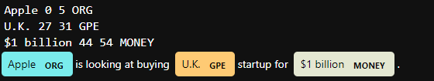
ML-Based NER – Program with Visualization
#NER using SpaCy's Pre-trained Model
import spacy
from spacy import displacy
# Load SpaCy's pre-trained model
nlp = spacy.load("en_core_web_sm")
# Sample text
text = "Apple is looking at buying U.K. startup for $1 billion."
# Process the text
doc = nlp(text)
# Print named entities
for ent in doc.ents:
print(ent.text, ent.start_char, ent.end_char, ent.label_)
# Visualize the entities
displacy.render(doc, style="ent", jupyter=True)

Slide 82
BERT
Bidirectional Encoder Representations from Transformers
A large language model developed by Google AI in 2018
It is:
Pretrained with two unsupervised tasks: Masked Language Modeling (MLM) (i.e. prediction of randomly masking words from the input sentence) and Next Sentence Prediction (NSP)
Bidirectional: deeply fuse the left and right context in the learned representation of each token.
Example for MLM:
Original Sentence: "The quick brown fox jumps over the lazy dog."
Masked Sentence: "The quick [MASK] fox jumps over the lazy [MASK]."
Task: Predict the words "brown" and "dog".
Example for NSP:
Sentence A: "The quick brown fox jumps over the lazy dog."
Sentence B (IsNext): "The dog did not wake up."
Sentence B (NotNext): "He went to the market to buy vegetables.
Read More:
https://medium.com/dataness-ai/exploring-bert-feature-extraction-fine-tuning-6d6ad7b829e7
https://www.geeksforgeeks.org/explanation-of-bert-model-nlp/

Slide 83
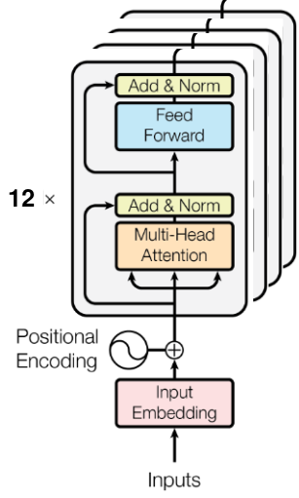
BERT Architecture
Composed of multiple encoder layers that apply self-attention to its input and pass it to the following layer
The smallest BERT model, BERT BASE, has an architecture composed of 12 encoder layers (cf. Figure 2), 768 hidden units in its feed-forward neural network block, and 12 attention heads.
BERT takes as input, sequences that are composed of sentences or pairs of sentences (<question, answer> for question-answering tasks).

Slide 84
Input Representations of BERT
Input sequences are prepared before being fed to the model using WordPiece Tokenizer with a 30k vocabulary size.
It works by splitting a word into several subwords (Tokens).
The use of subwords instead of words significantly reduces the total vocabulary size (only 30k) and the number of potential out-of-vocabulary (OOV) tokens.
Special tokens are:
[CLS] used as the first token of each sequence.
[SEP] used to separate the pair of sentences in the input sequence (e.g. question answering) or as the end token.
[PAD] used to represent paddings in the input sentences (empty tokens). The model expects fixed-length sentences as input. A maximum length is thus fixed depending on the dataset. Shorter sentences are padded, whereas longer sentences are truncated.

Slide 85
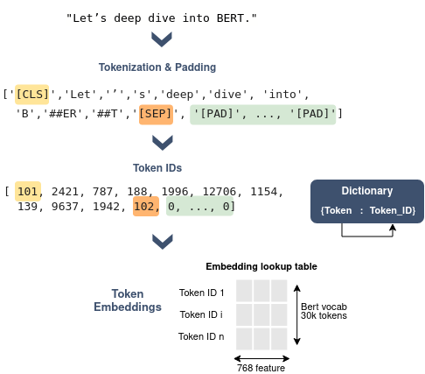
Sentence Encoding using BERT
Each token will be then encoded by its ID which corresponds to its index in the vocabulary.
For each token, the input representation is the sum of the token, the segmentation, and the positional embeddings
A lookup table provides the token embedding
Here rows represent all possible token IDs in the vocabulary (30k rows for instance) and columns represent the embedding size.
Segmentation embedding indicates if a given token belongs to the first or second sentence
Positional embedding indicates the position of tokens in a sentence

Slide 86
BERT for NER
from transformers import AutoTokenizer, AutoModelForTokenClassification
from transformers import pipeline
# Load pre-trained BERT model and tokenizer
model_name = "dbmdz/bert-large-cased-finetuned-conll03-english"
tokenizer = AutoTokenizer.from_pretrained(model_name)
model = AutoModelForTokenClassification.from_pretrained(model_name)
# Initialize the NER pipeline
ner_pipeline = pipeline("ner", model=model, tokenizer=tokenizer, aggregation_strategy="simple")

Slide 87
BERT for NER contd
# Sample text
text = "John Doe works at Microsoft in Redmond. Contact him at john.doe@example.com."
# Perform NER
results = ner_pipeline(text)
# Extract and print entities
for entity in results:
print(f"Entity: {entity['entity_group']}, Text: {entity['word']}, Score: {entity['score']:.2f}")
# You can also print the complete results to understand the structure
print(results)

Slide 88
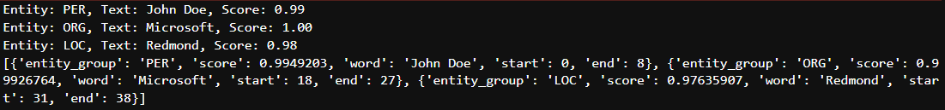
BERT for NER Output

Slide 89
BERT for NER Explanation
Import Libraries:
AutoTokenizer and AutoModelForTokenClassification: These are used to load the pre-trained BERT tokenizer and model.
pipeline: This is used to create a high-level NER pipeline
Load Pre-trained Model and Tokenizer:
dbmdz/bert-large-cased-finetuned-conll03-english: A pre-trained BERT model fine-tuned on the CoNLL-2003 dataset for NER.
Initialize the NER Pipeline:
The pipeline function initializes the NER pipeline with the specified model and tokenizer.
Sample Text:
Define a sample text to perform NER on.

Slide 90
BERT for NER Explanation
Perform NER:
The ner_pipeline function processes the text and identifies named entities.
Aggregation Strategy:
The aggregation_strategy="simple" parameter added to the pipeline function merges the subword tokens into complete entities.
Iterate and Print Entities:
The loop iterates over the results and prints the entity type, the complete word, and the confidence score.

Slide 91
Different BERT Models
BERT-Base and BERT-Large
BERT-Base: 12 layers, 768 hidden units, 12 attention heads, 110M parameters.
BERT-Large: 24 layers, 1024 hidden units, 16 attention heads, 340M parameters.
Use Cases: These models are general-purpose and can be fine-tuned for a variety of NLP tasks, such as text classification, named entity recognition (NER), question answering, and more.
DistilBERT
Description: A smaller, faster, and lighter version of BERT with 40% fewer parameters while retaining 97% of its language understanding capabilities.
Use Cases: Ideal for scenarios where computational resources are limited or low-latency applications like mobile devices and real-time inference.
RoBERTa (Robustly optimized BERT approach)
Description: A robustly optimized version of BERT that removes the next sentence prediction objective and is trained on more data for longer periods.
Use Cases: Text classification, sentiment analysis, and other tasks requiring improved performance over the original BERT.

Slide 92
Different BERT Models contd
BioBERT
Description: BERT model pre-trained on large-scale biomedical corpora.
Use Cases: Biomedical text mining, entity recognition in medical texts, and other biomedical NLP tasks.
ClinicalBERT
Description: A BERT model fine-tuned on clinical notes and medical records.
Use Cases: Extracting information from clinical records, predicting patient outcomes, and other healthcare-related NLP tasks.
SciBERT
Description: BERT model pre-trained on scientific literature.
Use Cases: Scientific text mining, information extraction from research papers, and other scientific NLP tasks.
M-BERT (Multilingual BERT)
Description: BERT model trained on Wikipedia pages of 104 languages.
Use Cases: Multilingual text classification, cross-lingual transfer learning, and other multilingual NLP tasks.

Slide 93
BERT Use Case Examples
Text Classification: Fine-tuning BERT on datasets like IMDB for sentiment analysis or AG News for topic classification.
Named Entity Recognition (NER): Fine-tuning BERT on datasets like CoNLL-2003 for extracting entities such as names, dates, and locations.
Question Answering: Using BERT models fine-tuned on SQuAD to build systems that answer questions based on context.
Text Summarization: While BERT itself is not typically used for summarization, its embeddings can be used in conjunction with other models for extractive summarization.
Text Generation: Pre-trained BERT models can serve as encoders in encoder-decoder architectures for text generation and translation tasks.

Slide 94
Extracting Structured Information from Unstructured Text
Structured information extraction is a crucial process in natural language processing (NLP)
Involves converting unstructured text data into a structured format that can be easily analyzed
Refers to the techniques and methodologies used to identify and extract meaningful data from unstructured text
Unstructured text, such as documents, emails, or social media posts, often contains valuable information that is not organized in a predefined manner.
For businesses and organizations, this process is essential for deriving actionable insights, making informed decisions, and gaining a competitive edge.

Slide 95
Examples of Structured Information
Databases: Databases are collections of organized data that can be easily retrieved, updated, and managed. They store information in tables with rows and columns, where each column represents a specific attribute, and each row represents a record.
Tables: Tables are a fundamental way of organizing data in a grid format, where information is arranged in rows and columns. Each column represents a different attribute or field, while each row represents an individual record or instance.
Spreadsheets: Spreadsheets are electronic documents that organize data into rows and columns, allowing for easy manipulation and analysis. They are commonly used for tasks such as financial modeling, data analysis, and project management.

Slide 96
Techniques for Extracting Structured Information
Entity Extraction
Identifying specific data points (e.g., names, dates, locations)
Also known as Named Entity Recognition (NER)
The goal is to locate the entities within the text and categorize them into predefined classes.
Relationship Extraction
Finding and categorizing relationships between entities (e.g., person-to-organization)
Aims to uncover how the entities are connected.
Event Extraction
Identifying and categorizing events mentioned in the text
Events are occurrences or actions that involve entities and often include temporal and contextual information
Examples of events include product launches, meetings, disasters, and negotiations.

Slide 97
Entity Extraction Using Spacy
import spacy
# Load pre-trained spaCy model
nlp = spacy.load("en_core_web_sm")
# Sample texttext = "Apple Inc. is looking at buying U.K. startup for $1 billion.“
# Process text
doc = nlp(text)
# Extract entities
entities = [(ent.text, ent.label_) for ent in doc.ents]
print("Entities:", entities)

Slide 98
Relationship Extraction with scikit-learn
from sklearn.feature_extraction.text import CountVectorizer
from sklearn.svm import SVC
from sklearn.pipeline import make_pipeline
from sklearn.model_selection import train_test_split
# Sample data
texts = ["Apple Inc. is buying U.K. startup.",
"Microsoft is acquiring LinkedIn.",
"Tesla is investing in renewable energy."]
labels = ["Acquisition", "Acquisition", "Investment"]
# Vectorize text
vectorizer = CountVectorizer()
X = vectorizer.fit_transform(texts)
# Train model
model = SVC(kernel='linear')
model.fit(X, labels)
# Predict relationship
new_text = ["Google is acquiring Fitbit."]
X_new = vectorizer.transform(new_text)
prediction = model.predict(X_new)
print("Predicted Relationship:", prediction[0])

Slide 99

Event Extraction using spaCy with Custom Rules
import spacy
from spacy.matcher import Matcher
# Load pre-trained spaCy model
nlp = spacy.load("en_core_web_sm")
# Initialize Matcher
matcher = Matcher(nlp.vocab)
# Define a very simple pattern for matching
pattern = [{"LOWER": "launch"}] # Match just the word "launch"
matcher.add("EVENT_SIMPLE", [pattern])
# Sample text
text = "The launch of the new iPhone was announced last week."
# Process text
doc = nlp(text)
# Extract events
matches = matcher(doc)
# Print events
events = [doc[start:end].text for match_id, start, end in matches]
print("Events:", events)

